Slide 1
Controlled vocabularies, Ontologies, and data linking
BDK14-1 | Ontologies 101
Melissa Haendel and Nicole Vasilevsky

Slide 2
Learning Objectives
1
Compare an ontology to other types of controlled vocabularies
Describe the key features of an ontology
Identify uses cases for ontologies
2
3

Slide 3
Why do we need ontologies?
Describing the problem

Slide 4
We can’t find what we’re looking for
A folksonomy: NCBI BioSample
Just kill me now:
Too flexible, multiple options, no enforcement standards
standardized
quasi-standardized
non-standardized
Data at varying depth or granularity
Query | # records
Feces | 22,592
Faeces | 1,750
Ordure | 2
Dung | 19
Manure | 154
Excreta | 153
Stool | 22,756
Stool NOT faeces | 21,798
Stool NOT feces | 18,314
Notes:
Example from Owen White

Slide 5
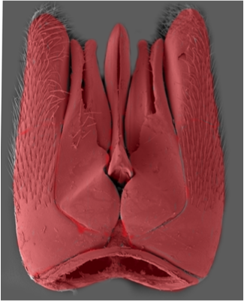
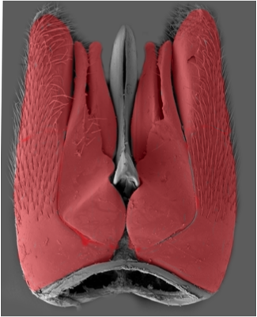
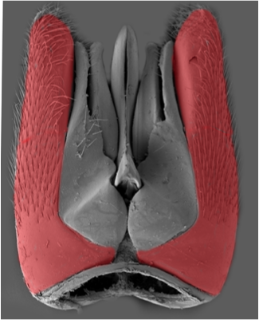
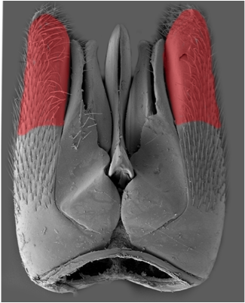
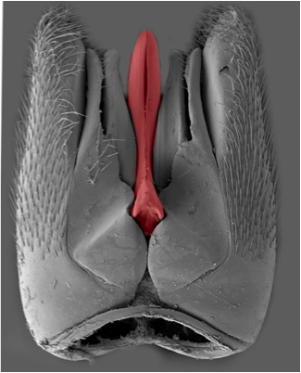
And even when we do, we don’t know what we’re talking about
paramere?
Notes:
Image courtesy of Matt Yoder
But because we have no single reference glossary the result is millions of statements that are not obviously related
here is the male genitalia of a gasteruptiid wasp.
these 5 different structures here have each been labeled "paramere" - by different people, studying different hymenopteran lineages

Slide 6

Semantics for your data
Ontologies enable organizing, filtering, connecting and suggesting data

Slide 7
Who are ontologists?
Philosophers
Philosophical
Mathematicians
YOU
Scientists
Perfect Logical Consistency
Computer Scientists
Pragmatic Mostly Works
Engineers
Gobel and Wroe 20014
Notes:
Citation: http://onlinelibrary.wiley.com/doi/10.1002/cfg.442/abstract;jsessionid=B8B0E8490C2949A70B1B904F2BC4EE1F.f03t01?userIsAuthenticated=false&deniedAccessCustomisedMessage=

Slide 8
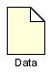

Controlled vocabularies are used to annotate data
An annotation is extra information attached to a data item
The goal is to add value by enabling:
- Indexing data
- Linking data
Annotation of data makes it easier to find and group data

Slide 9
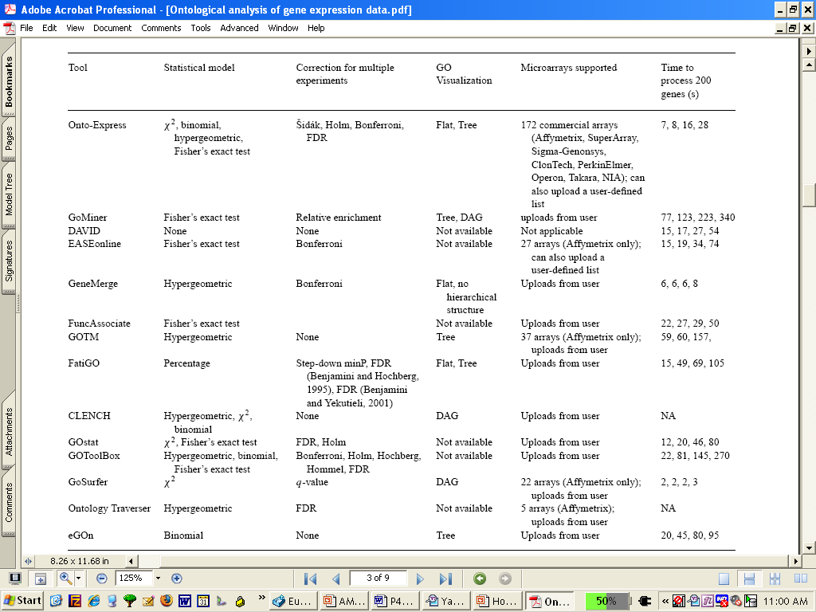
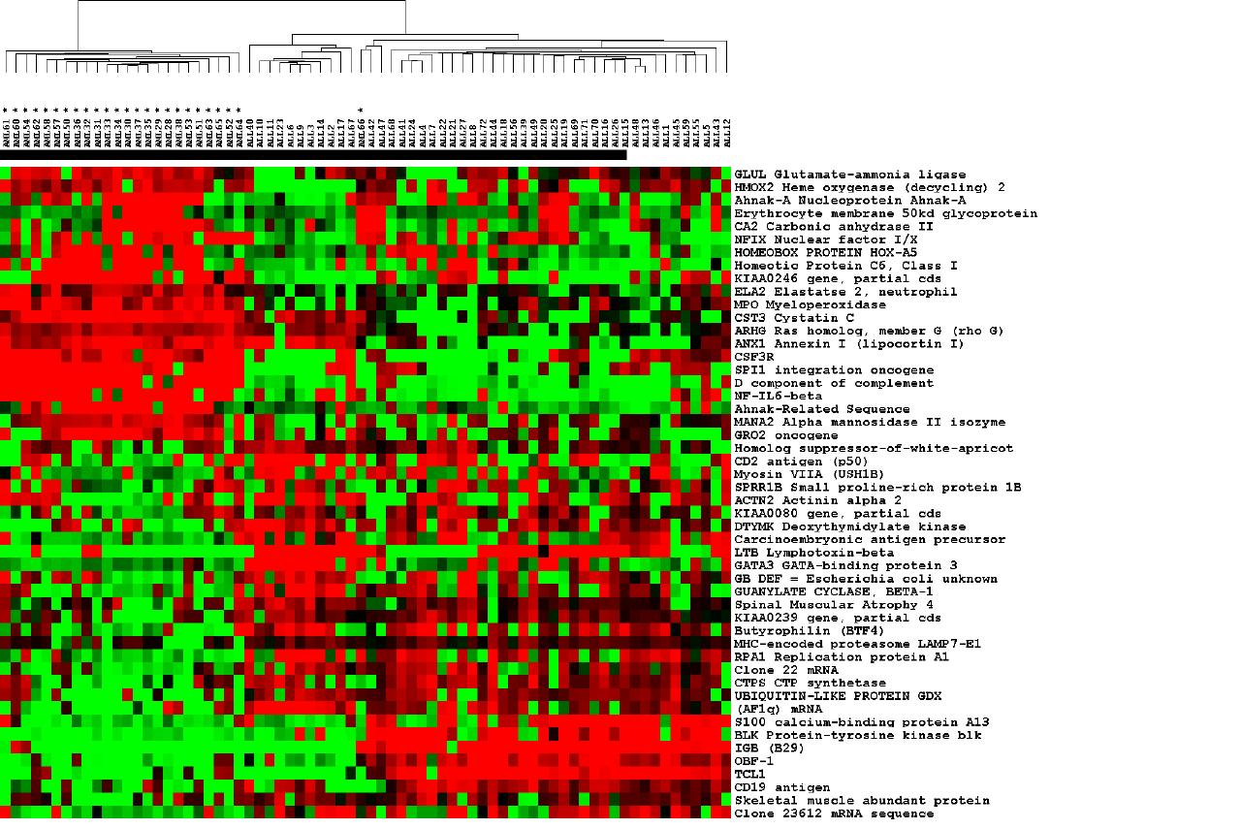
Shared controlled vocabularies indicate the same meaning
MouseEcotope
GlyProt
sphingolipid
transporter
activity
DiabetInGene
GluChem

Slide 10
Controlled vocabularies

Slide 11

What is a Controlled Vocabulary?
Definition:
Any closed, prescribed list of terms
Key Features:
Terms are not usually defined
Relationships between the terms are not usually defined
Simplest form is a list
CV of wines:
Pinot noir
Red
Chardonnay
Chianti
Bordeaux
Riesling
…
These are all different types:
color
location
varietal
Notes:
Another example would be the map locations list at the end of your Gazeteer.

Slide 12
What is a Taxonomy?
Definition:
Any controlled vocabulary that is arranged in a hierarchy
Key Features:
Terms are not usually defined
Relationships between the terms are not usually defined
Terms are arranged in a hierarchy
Taxonomy of wines:
Red
Merlot
Zinfandel
Cabernet
Pinot Noir
White
Chardonnay
Pinot Gris
Riesling

Slide 13
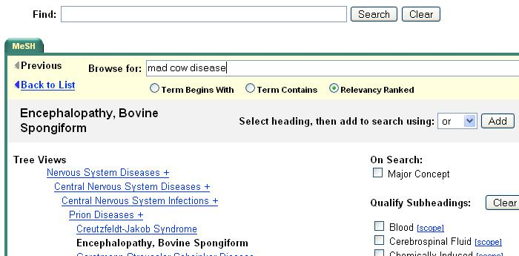
What is a Thesaurus?
Definition:
A taxonomy that contains additional information about use of the terms
Key Features:
Terms are not usually defined
Relationships between the terms are not usually defined
Terms are arranged in a hierarchy
Scope notes or instructions for use are included
Examples
WordNet
NCI Cancer Thesaurus
MeSH

Slide 14
What is an Ontology?
Definition:
A formal conceptualization of a specified domain
Key Features:
Terms are defined
Relationships between terms are defined, allowing logical inference and sophisticated data queries
Terms are arranged in a hierarchy
Expressed in a knowledge representation language such as RDFS, OBO, or OWL
Examples:
SNOMED, Foundational Model of Anatomy, Gene Ontology, Linnean Taxonomy of species

Slide 15
Complexity of Vocabulary types
Connectedness
capture logical, non-hierarchical relationships across the model
Ontologies
‘controlled vocabulary’
types
Taxonomies
OWL
Semantic Precision
Enterprise Data Models
Concept Maps
Expressivity
formal languages amenable to computational reasoning
Controlled vocabularies
RDF
Thesaurus
UML, XMI
Glossaries
Abstraction
not tied to a particular implementation
formats,
languages
XML, XSLT
Word/HTML
Time/Money
Notes:
An ontology is . . .
Here we see where ontologies fall along a spectrum of controlled vocabulary types which range from simple lists of terms and definitions in glossaries and thesauri, to more elaborate hierarchical representations in taxonomies such as MeSH and ontologies such as Gene Ontology. Note that these ontological artifacts are more semantically precise but also more expensive to build
Image adapted from: http://www.mkbergman.com/date/2007/05/16/

Slide 16
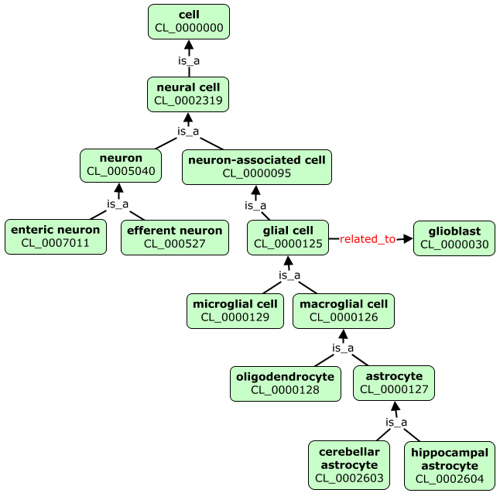
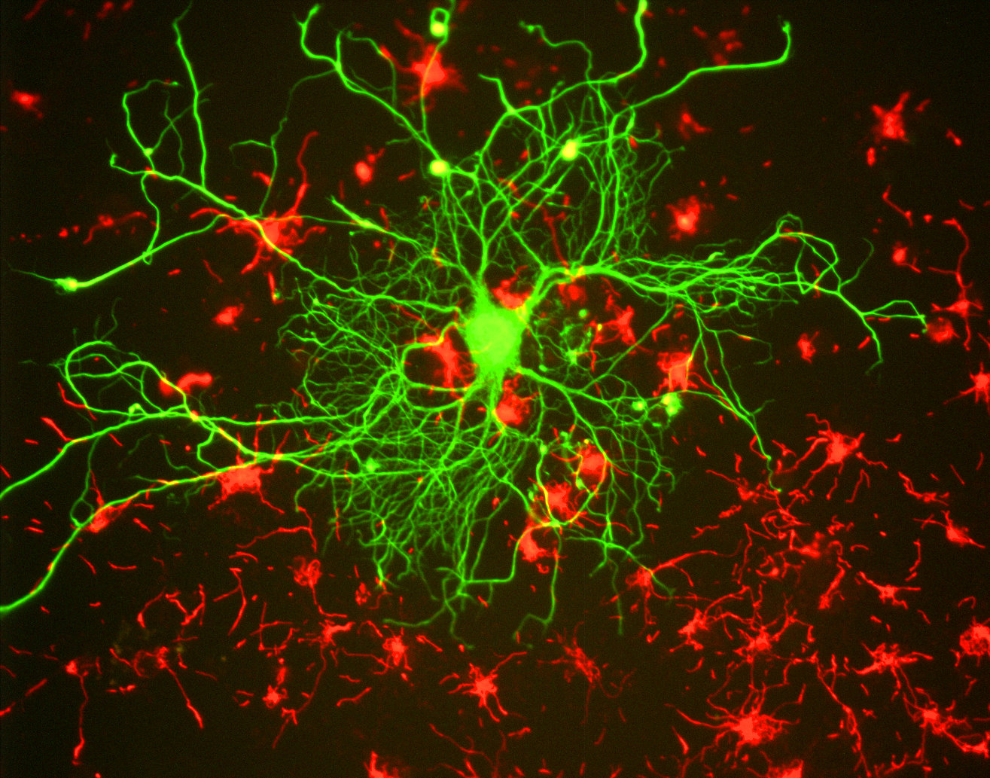
Example taxonomy
Notes:
Image credit: https://en.wikipedia.org/wiki/Neurofilament

Slide 17
Hierarchical Query Expansion
Genes annotated as being expressed in different types of glial cells
Glial cell 20
Macroglial cell 15
Microglial cell 10
Query ‘glial cell’ without hierarchy Results = 20
Glial cell 20
Macroglial cell 15
Microglial cell 10
Query ‘glial cell’ with hierarchy Results = 45

Slide 18
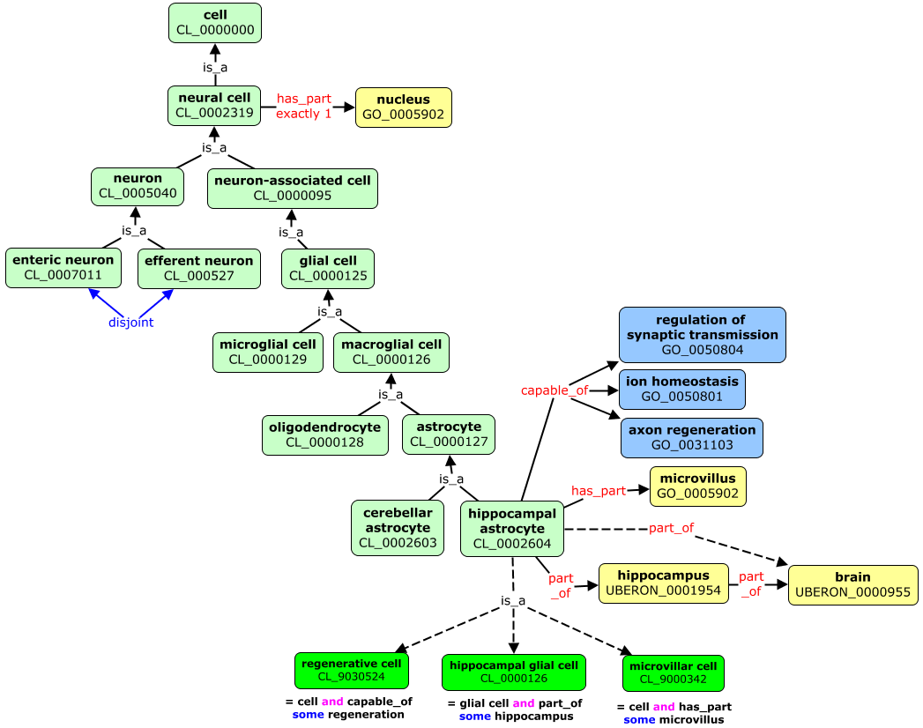
Ontologies
Ontologies support automated consistency checking, inferred classification along different axes, and powerful
graph-based applications
Notes:
Many associative relationships between classes create network structure
Much richer domain model
Well-supported by communities and standards
Encoded in more expressive logic-based language (OWL) & confers stronger semantics to relationships
Cardinality, Disjointness, Transitivity, Necessary and sufficient conditions for class membership

Slide 19
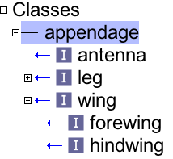
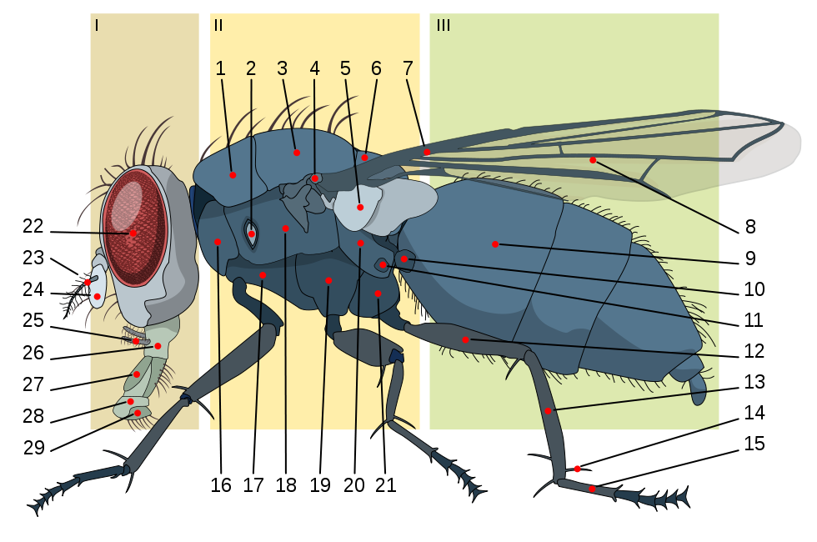
Ontologies are formal classifications
appendage
antenna
wing
fore
wing
hindwing
Notes:
Image credit: https://en.wikipedia.org/wiki/Housefly#/media/File:Housefly_anatomy-key.svg

Slide 20
Relationships also support classification
‘leg’ SubClassOf part_of some thoracic segment
part_of some ‘thoracic segment
wing
leg
Notes:
Make note that these are “controlled properties”
Image credit: https://en.wikipedia.org/wiki/Housefly#/media/File:Housefly_anatomy-key.svg

Slide 21
Necessary and sufficient conditions
Any sense organ that functions in the detection of smell is an olfactory sense organ
olfactory
sense
organ
capable_of some detection of smell
sense organ

Slide 22
Classifying
capable_of some
detection of smell
sense organ
nose
nose
olfactory
sense
organ
capable_of some detection of smell
sense organ
nose
These are necessary and sufficient conditions, also called an equivalent class axiom
Notes:
Also point out the functional classification axis

Slide 23
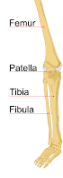
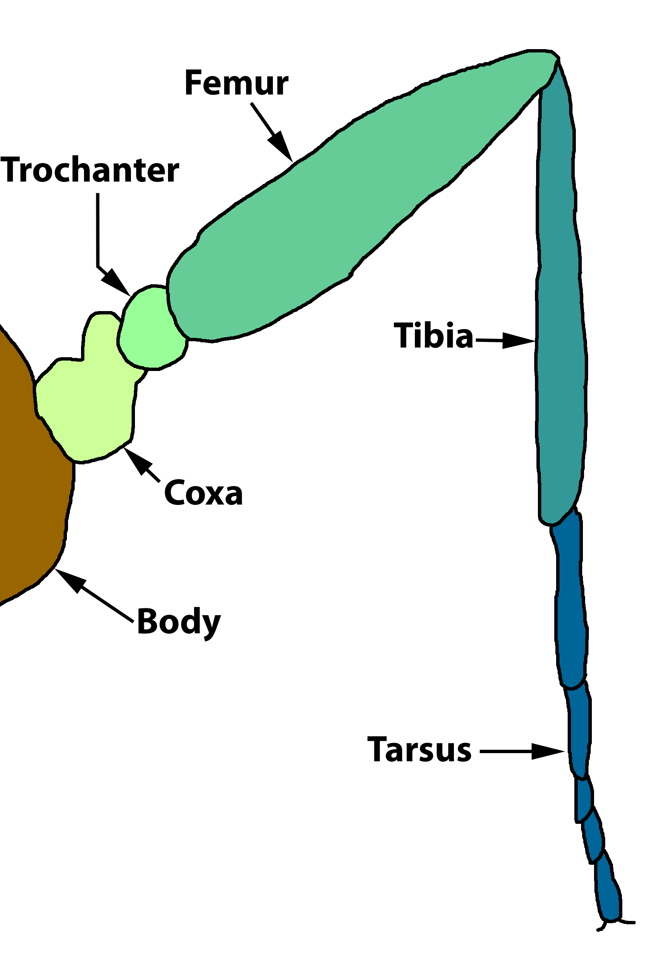
Using reasoners to detect errors
only_in_taxon
UBERON: bone
Vertebrata
disjoint_with
is_a
is_a
Drosophila melanogaster
UBERON: tibia
Homo sapiens
is_a
✗
is_a
part_of
part_of
Fruit fly FBbt ‘tibia’
Human FMA ‘tibia’
Notes:
Uberon uses the only_in_taxon method to make relationships such as lactifierous gland only in taxon Mammalia and bone
only in taxon Vertebrata. These relations are useful for human users of the ontology, and can be used for
consistency checking within the ontology. For example if the FBbt class “tibia” (representing a segment of
an insect leg) were accidentally placed as a child of UBERON:0000979 tibia, this would be flagged by the
reasoner because tibia is a bone, bones are found only in vertebrates, and FBbt is a Drosophila ontology
Images: https://upload.wikimedia.org/wikipedia/commons/thumb/7/7e/Human_leg_bones_labeled.svg/2000px-Human_leg_bones_labeled.svg.png
https://upload.wikimedia.org/wikipedia/commons/3/30/InsectLeg.png

Slide 24
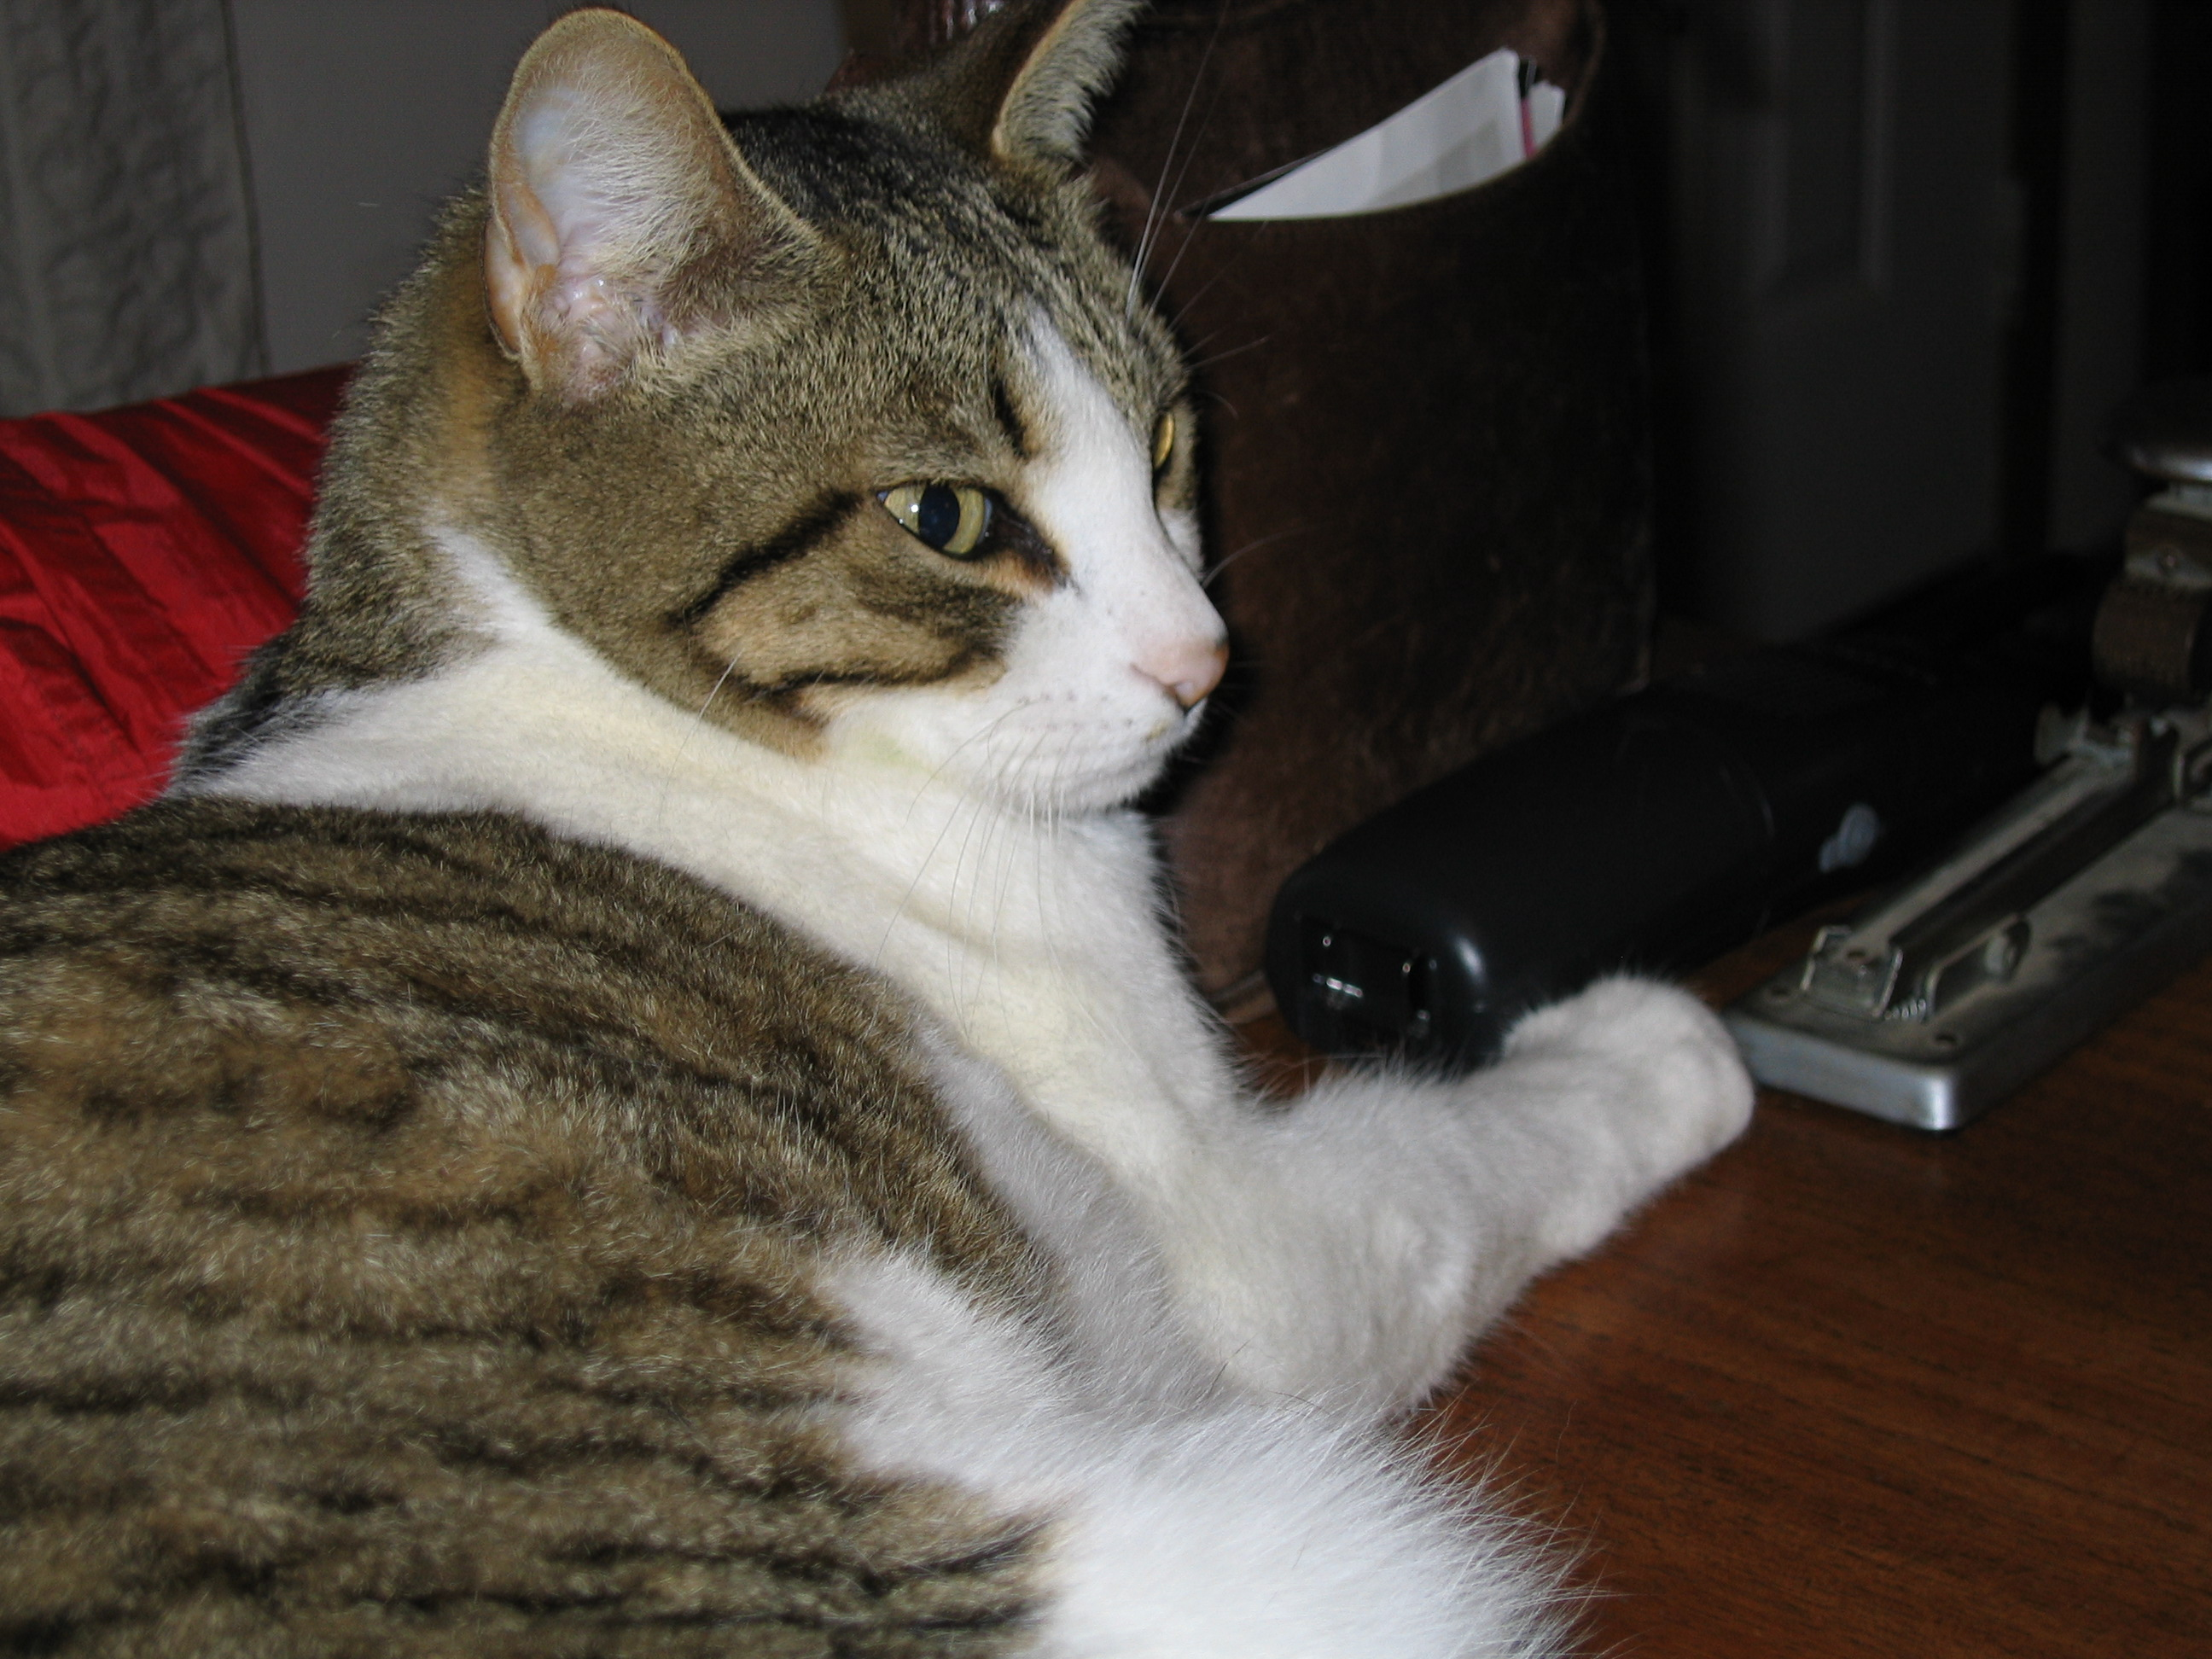
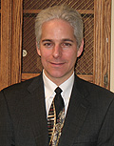
Types, subtypes, and instances
entity
is_a
organism
Subtyping
relation
is_a
animal
is_a
mammal
cat
is_a
is_a
human
instance_of
instance_of
Peanut
Chris Shaffer
is_a = SubClassOf = subtype
Notes:
NOTE: This subsumption depends on defining properties of the superclass. For example, not all mammals have mammary glands, so we could potentially define mammal as being member of a species for which there are female members that have a part mammary glad and some point during their life history.

Slide 25
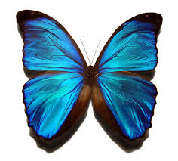
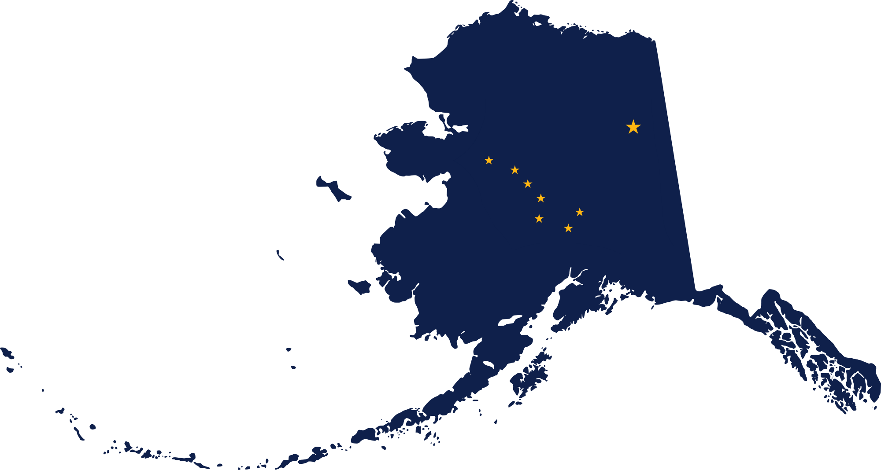
How do you tell if it is an instance or a class?
Is there more than one in existence?
Is the entity referencing a group of things with common properties?
Class or instance?
Class or instance?
There is only one Alaska
There is a class of things labeled “States”
There is only one blue morpho in my specimen collection
There is a class of things labeled “Blue morpho butterflies”
Notes:
Image credit: https://commons.wikimedia.org/wiki/File:Flag_map_of_Alaska.png
Image credit: https://en.wikipedia.org/wiki/File:Blue_morpho_butterfly.jpg

Slide 26
Are Ontologies the answer?
What is the question?
What is the domain?

Slide 27
YES
Well coordinated
community of experts
authorative users
Well defined
boundaries
limited concepts
stability
Notes:
Adapted from: www.shirky.com/writings/ontlogy_overrated.html

Slide 28
Structured Data FTW
(for the win)
Siri
Watson
Freebase
Wolfram Alpha(?!)
Notes:
Adapted from: www.shirky.com/writings/ontlogy_overrated.html

Slide 29
NO
many non-experts
no unified coordination
no authority
no clear boundaries
limitless content
instability
Notes:
Adapted from: www.shirky.com/writings/ontlogy_overrated.html

Slide 30
Roadblocks
(some)
front-end capture paradigms
end-user data repositories
curatorial commitment
collaborative editing?
ontology QA, testing
research patterns
integration
interfaces
Vue->OWL
Uber
Phenobank
Persistence
Provenance
who will
do the work?
use-cases
modularity
end-user
unified

Slide 31
Biological Ontologies
(have impact)

Slide 32
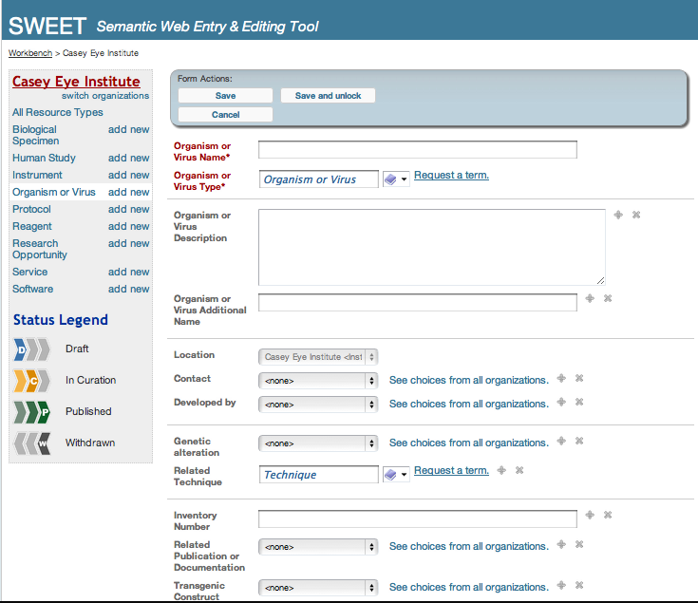
Driving a User Interface for quality data capture

Slide 33
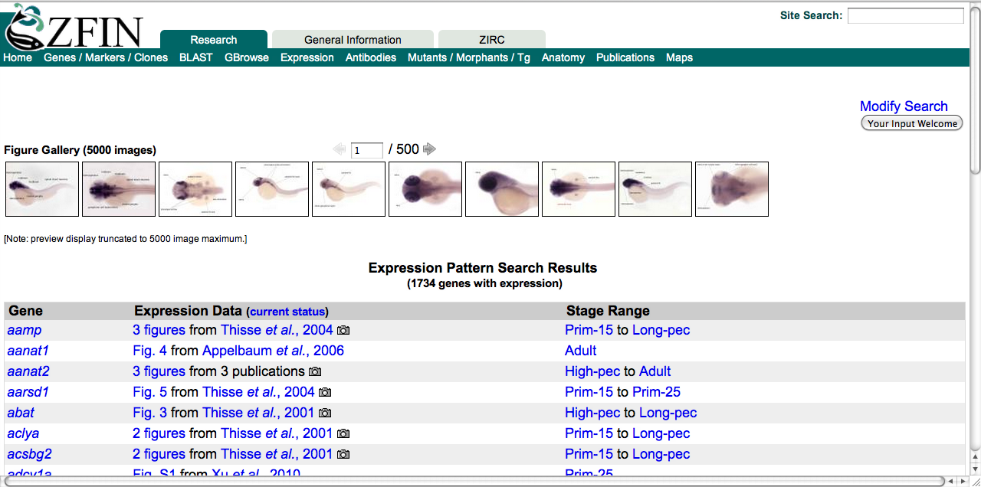
Querying anatomical data
Query for genes expressed in the retina and its parts:

Slide 34
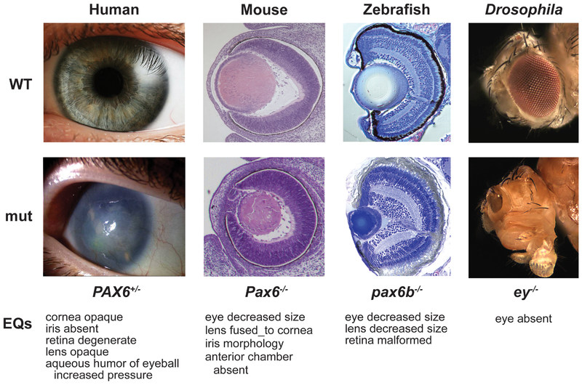
Semantic similarity of phenotypes for disease discovery
FMA+PATO
MP
ZFA+PATO
FBbt+PATO
"Linking Human Diseases to Animal Models Using Ontology-Based Phenotype Annotation." PLoS Biol 7(11): e1000247. doi:10.1371/journal.pbio.1000247 Washington NL, Haendel MA, Mungall CJ, Ashburner M, Westerfield M, Lewis SE

Slide 35

Resources:
Biological Ontologies
eagle-i Network data capture: www.eagle-i.net
Zebrafish Informatics Network gene expression query:
www.zfin.org
The Monarch Initiative disease discovery:
www.monarchinitiative.org

